Slide 1
Bike store sales project

Slide 2
Agenda
Project description
Data cleaning using Python
Objective
Data visualization using Tableau
Recommendations and conclusions

Slide 3

Project description

Slide 4
Introduction of Bike sales project
This project focuses on analyzing sales data from a bike store. The dataset contains detailed information about orders, including customer details, locations, order dates, product information, revenue, and sales representatives.
The goal of this analysis is to extract valuable insights regarding customer purchasing behaviors, product performance, and store profitability, ultimately supporting data-driven decision-making to improve sales strategies and market positioning.

Slide 5
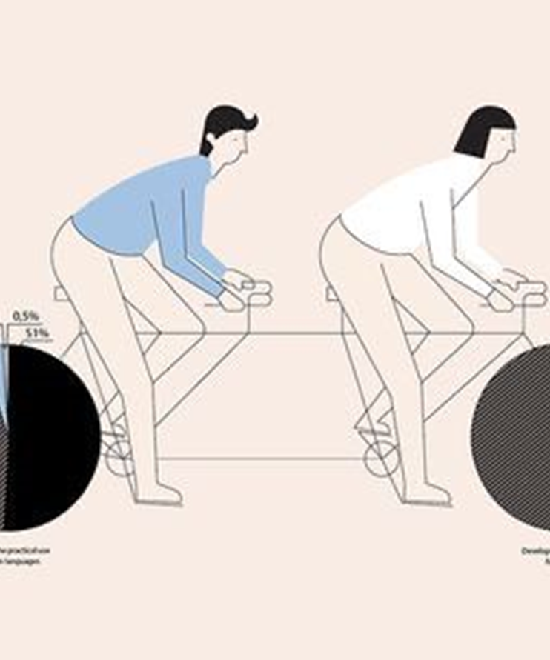
Data cleaning using Python
Data Cleaning:
No missing values
No duplicates
Order dates were converted into a standard format.
Mapping states from abbreviations to clarified ones.
Renaming column ‘sales rep’ to ‘sales representative’.
Converting numeric month values (1-12) to month names (January-December).
Exploratory Data Analysis (EDA): Initial exploration included identifying product categories, customer demographics, and regions.

Slide 6
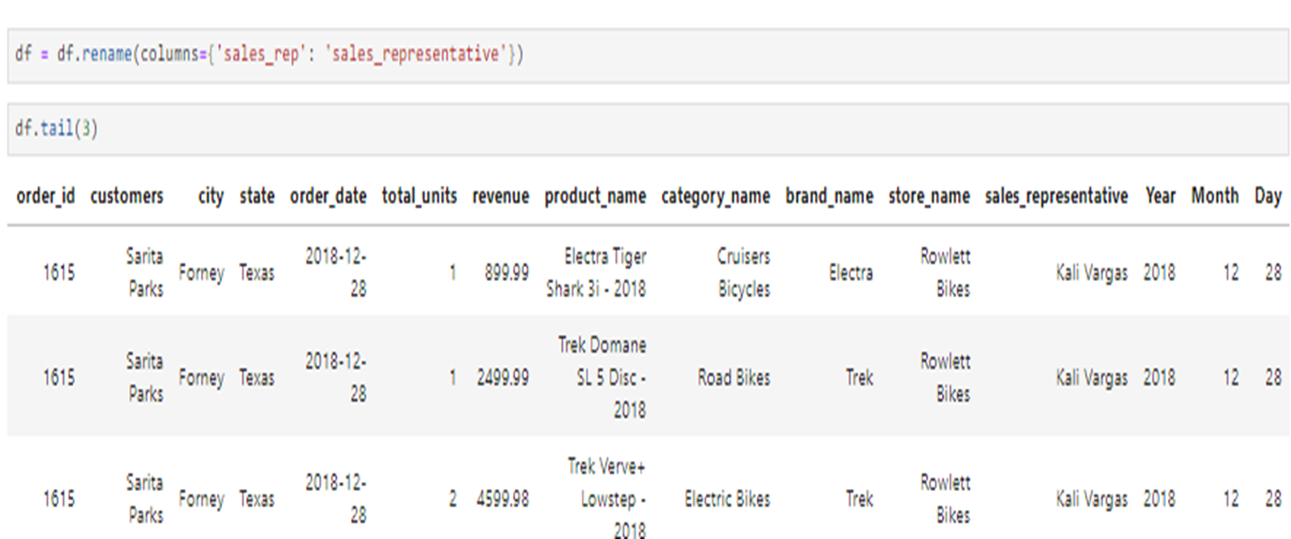
Renaming column ‘sales rep’ to ‘sales representative’

Slide 7
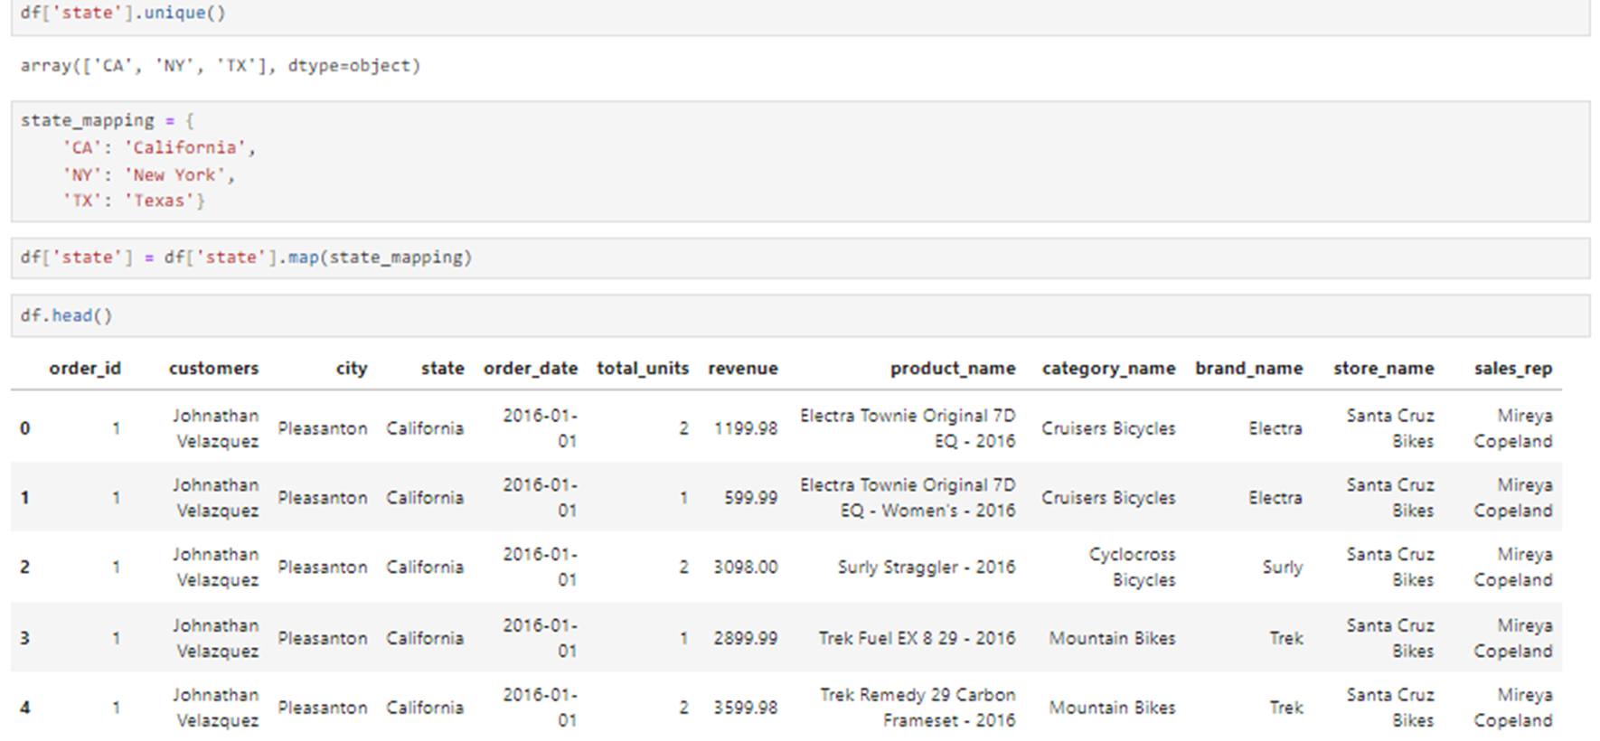
Mapping states from abbreviation to clarified

Slide 8
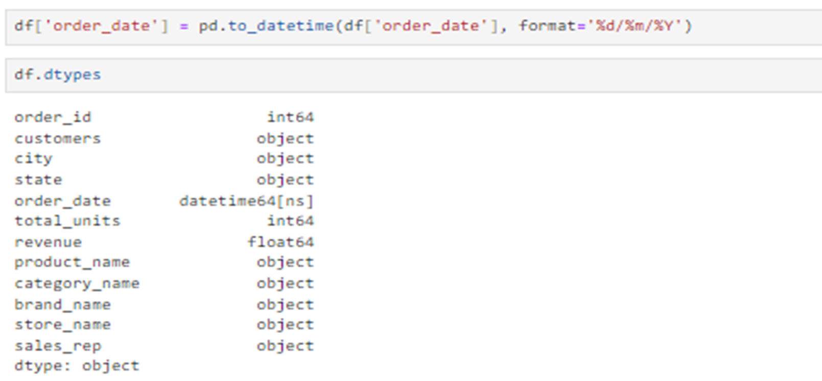
Order dates are converted into standard format

Slide 9
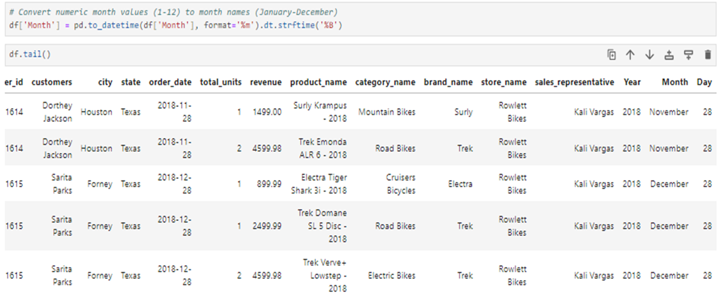
Convert numeric month values to month name

Slide 10

Objective
The key questions that guide the analysis

Slide 11
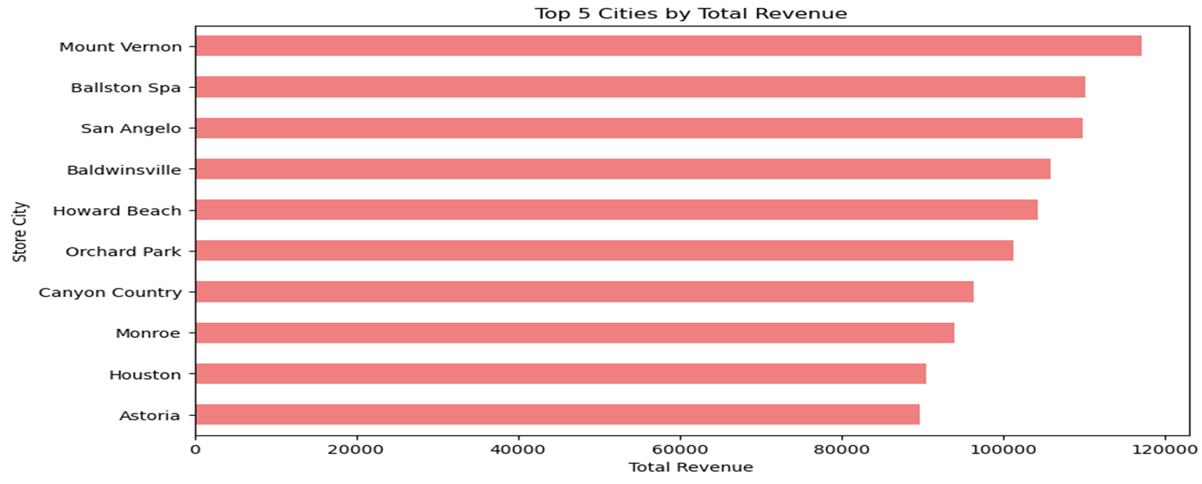
What are the Top 5 Cities that have Highest Revenue?

Slide 12
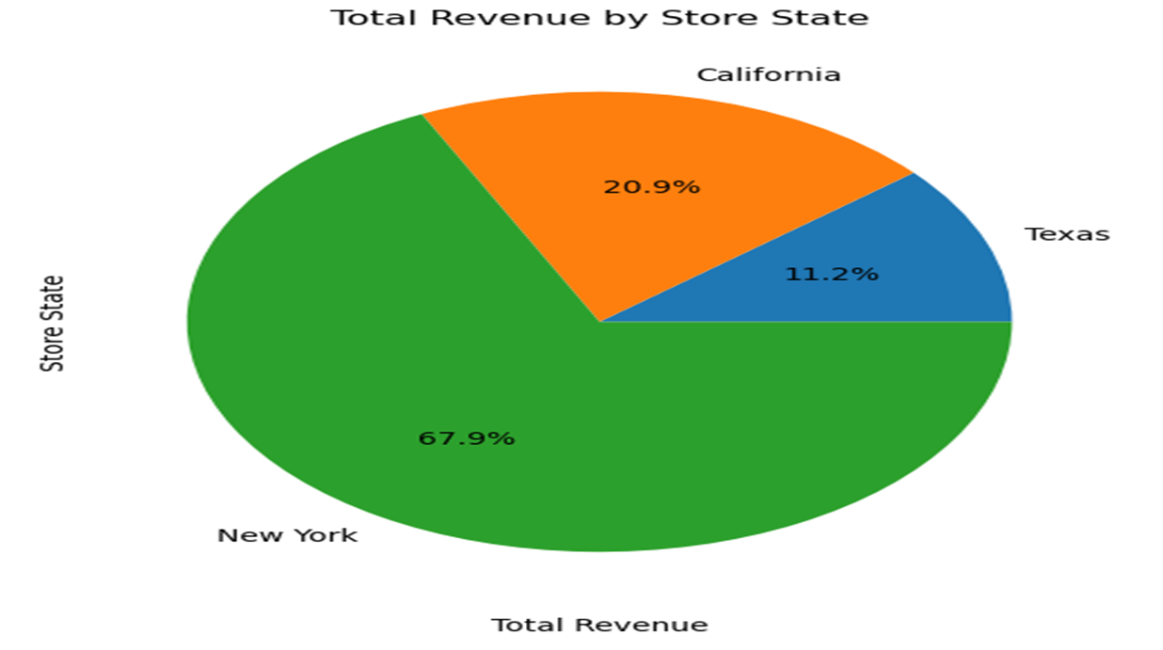
What are the Percentages of Store States regarding Revenue?

Slide 13
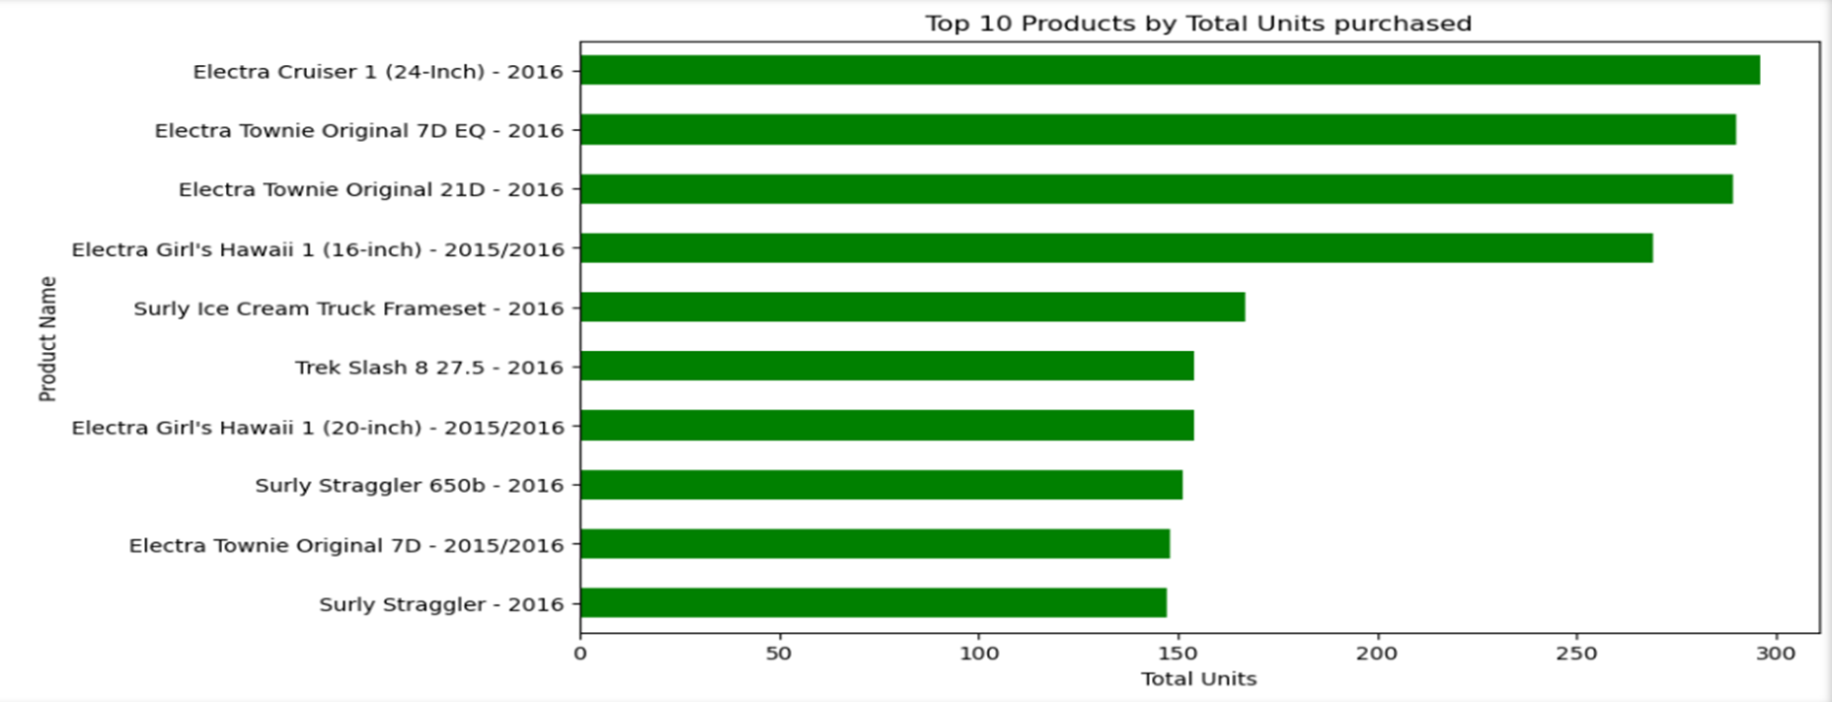
What are the most popular products in terms of units purchased?

Slide 14
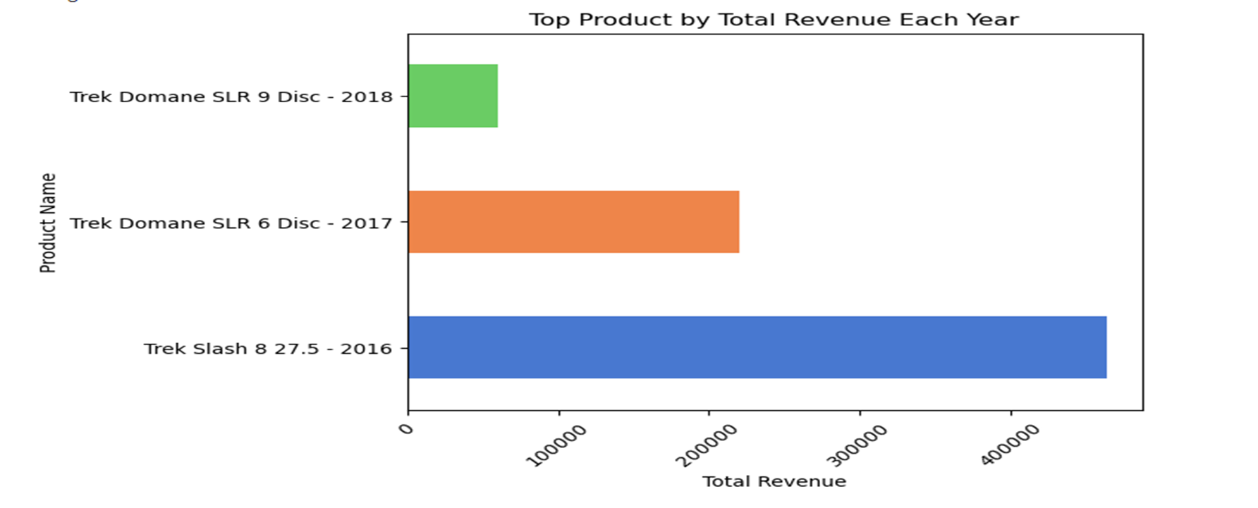
What is the Top popular product in terms of revenue generated each year?

Slide 15
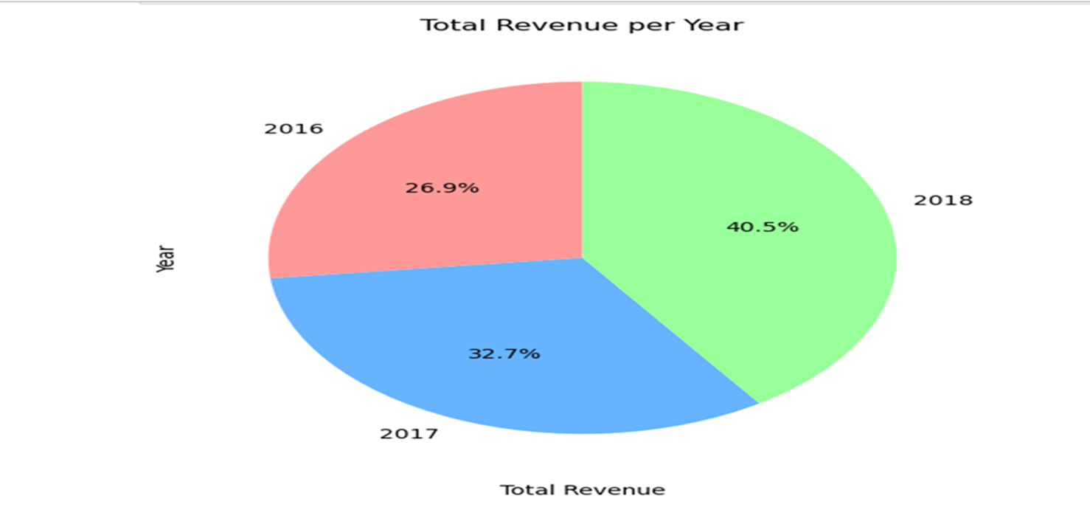
What is the Distribution of Revenue generated each year?

Slide 16
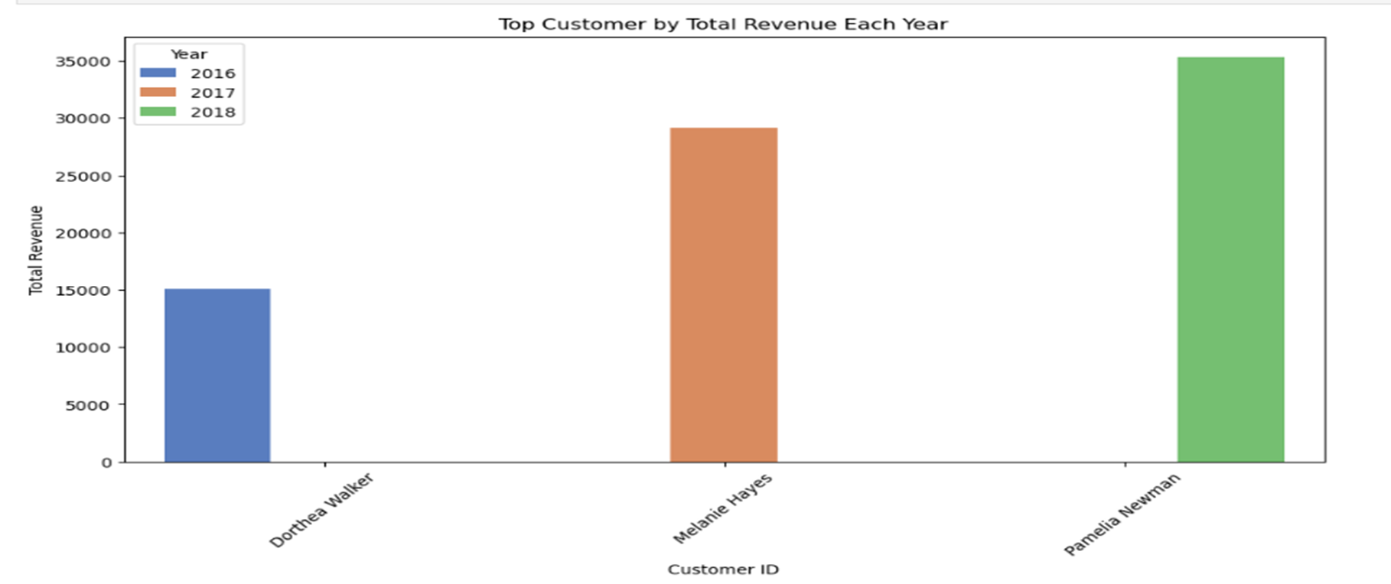
Who are the Top Customers contributed to Highest Revenue each year?

Slide 17
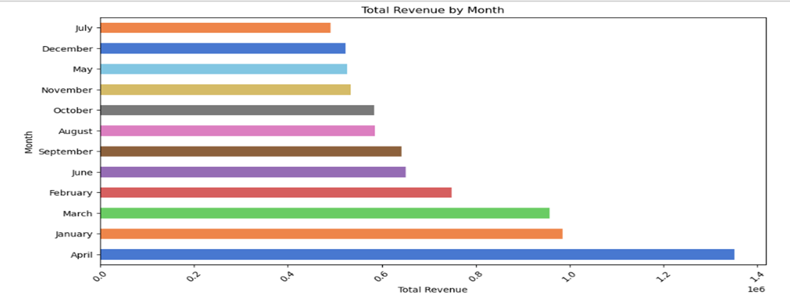
What are the months that have the maximum revenue?

Slide 18
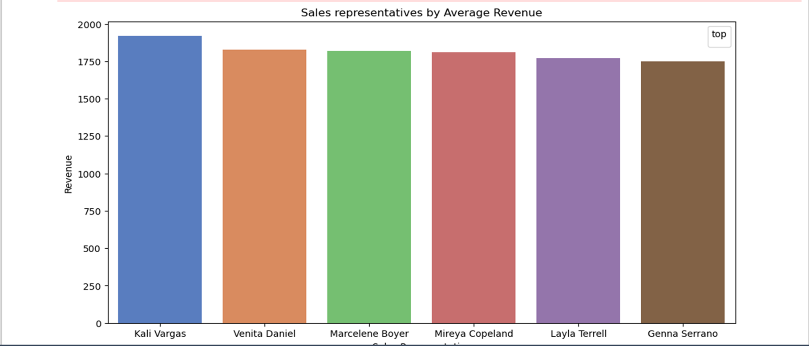
Which sales representatives and stores are top performers?

Slide 19
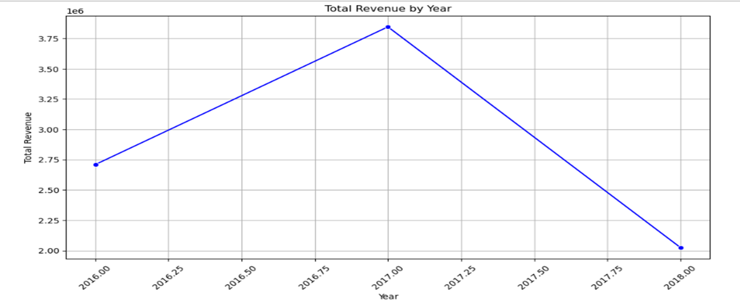
What seasonal trends can be observed in the sales data?

Slide 20

Data visualization using Tableau
Geographical Insights: A map visualization was used to show sales concentration across different cities and states.

Slide 21
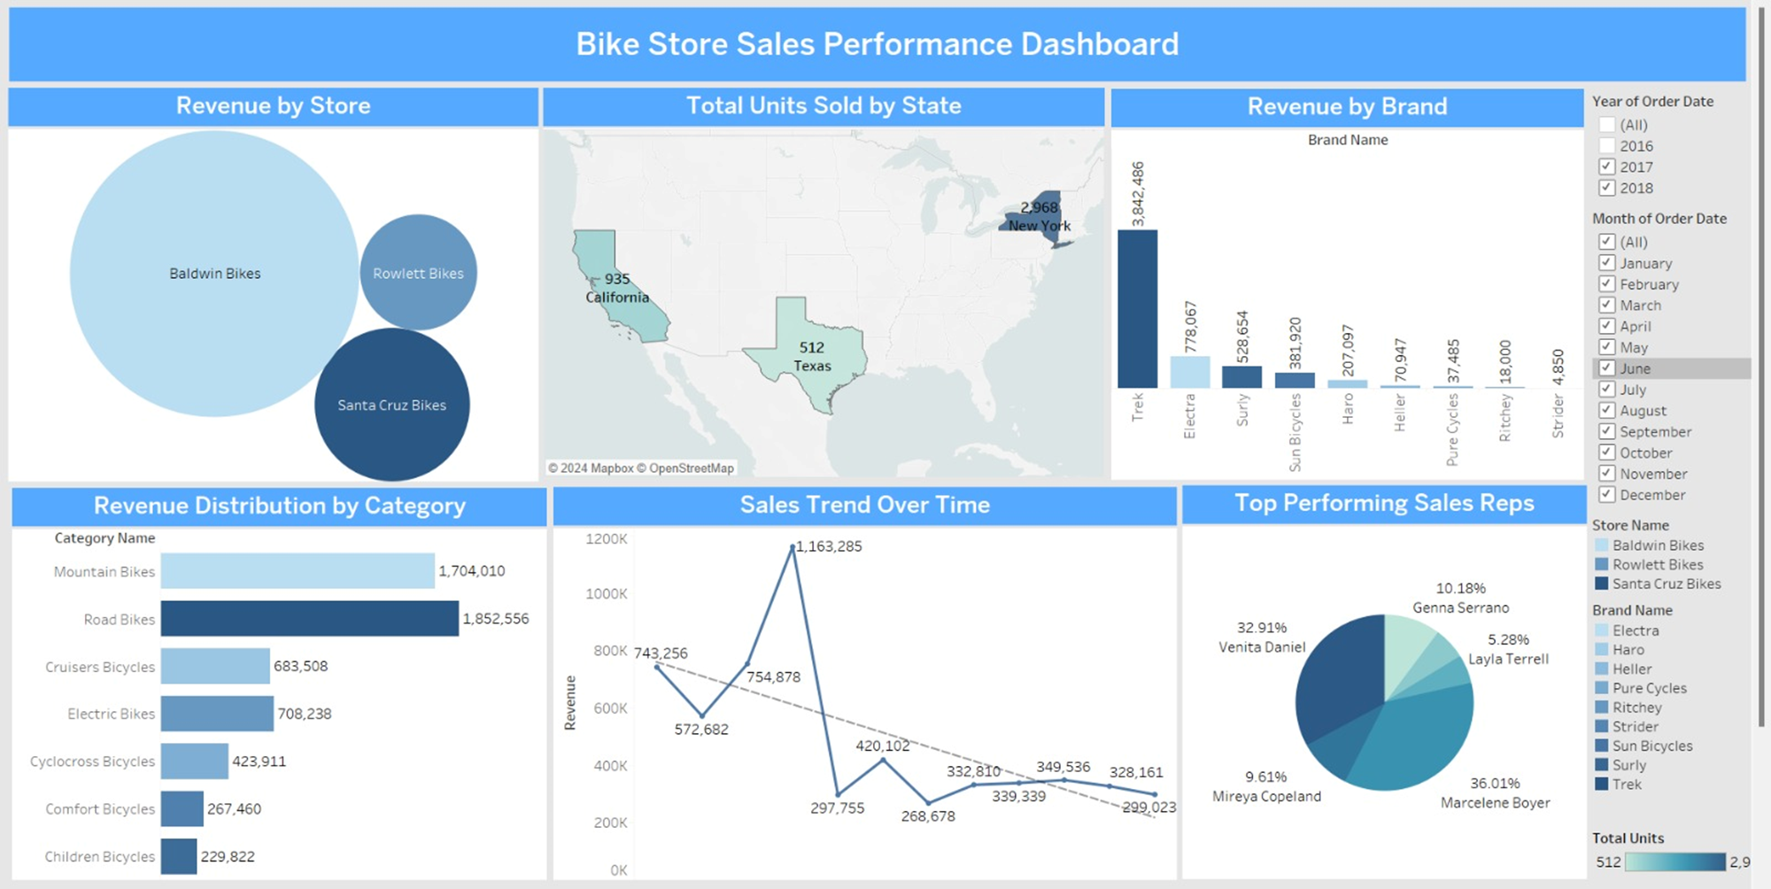
Dashboard of Bike store project

Slide 22

Insights

Slide 23
Based on the data analysis and visualizations, the following insights were drawn: 1. Top Cities: The most popular cities contributed to Highest Revenue were “Mount Vernon”, “Ballston Spa” and “San Angelo”. “New York” has achieved the highest percentage of Total Revenue followed by “California”. 2. Regional Sales Trends: States like “California” and “Texas” showed the highest sales volumes, with a marked increase during summer months. 3. Top Products: The most popular products in terms of units purchased were “Trek Slash 8 27.5 – 2016”, “Trek Conduit+ - 2016”, “Trek Fuel EX 8 29 – 2016” and “Surly Straggler 650b – 2016”. However, “2016” year has the lowest revenue distribution across the other years. 4. Top Products Per Year: The most popular products were “Trek Domane SLR 9 Disc – 2018”, “Trek Domane SLR 6 Disc – 2017” and “Trek Slash 8 27.5 – 2016”. These contributed significantly to overall revenue each year. 5. Top Customers: The popular customers who contributed the most regarding revenue were: Pamelia Newman in 2018 Melanie Hayes in 2017 Dorthea Walker in 2016

Slide 24

Recommendation and conclusion

Slide 25
Based on the insights, the following recommendations are proposed
Product Focus: Increase marketing efforts for Cruisers Bicycles and Mountain Bicycles in high-performing regions such as California and Texas to maximize sales.
Seasonal Promotions: Launch targeted promotions during holiday seasons and warmer months to take advantage of peak purchasing periods.
Sales Training: Provide additional training and resources to underperforming sales representatives and replicate the strategies of top performers like Kali Vargas.
Stock Optimization: Align inventory levels with regional and seasonal demand to prevent stock shortages during peak times.
Addressing Sales Decline in Winter: Implement additional offers and discounts on bike categories, particularly from June to December, as these winter months in 2018 showed the lowest revenue.
Bundling Offers: Create product bundles (bikes with accessories or maintenance services) at a reduced price to encourage larger purchases.
Early Bird Offers: Provide early-season discounts in June to boost sales before the typical decline begins.
Flash Sales: Host flash sales or “one-day only” events during low-revenue months to create urgency and drive immediate purchases.
In conclusion, this analysis provides actionable insights to support data-driven decisions that can improve market positioning and sales performance.

Slide 26
Thank you

